Slide 1
TRIP PLANNER APPLICATION
BATCH-05
K.YOKHALAKSHMI

Slide 2
PROBLEM STATEMENT
The application's database contains information on customers, country, Places, and Trip data. The database is designed using SQL to ensure efficient storage and retrieval of data. The application uses SQL queries to retrieve data based on user input and preferences, providing a personalized travel experience.The Trip Planner application allows users to create custom journey by selecting their travel dates, destinations, and activities. The application uses SQL queries to retrieve data on available customers, country, Places, and Trip data allowing users to make informed decisions about their travel plans

Slide 3
AIM
To provide trip planner service for customers to travel from one place to another through various vehicles.The customers have to book their vehicles through various web application.

Slide 4
SCHEMA
TABLES
Customer_Registered
Country
Places
Offers
Trip_data

Slide 5
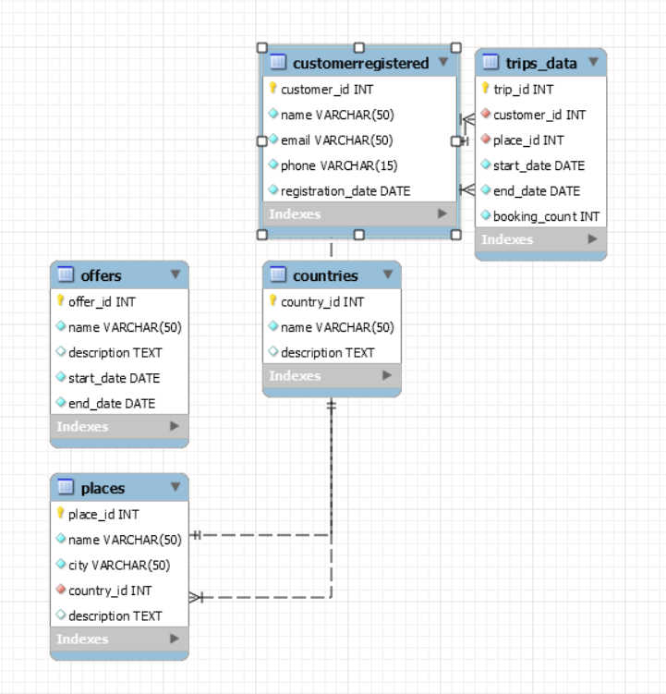
FLOW DIAGRAM

Slide 6
TOOLS USED
Tables - Tables are used to store and organize data. A table is a collection of related data that is organized into rows and columns. Each row represents a single record or instance of the data, while each column represents a specific attribute or property of the data.It consists of different components.
Joins - Joins are used to combine data from two or more tables in a relational database based on a related column between them. Joins are powerful operations that allow you to retrieve data from multiple tables and combine it into a single result set.

Slide 7
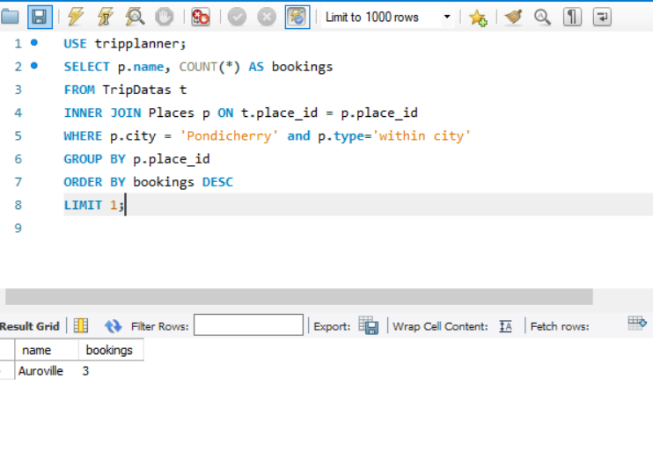
IMPLEMENTATION
Populate the data and display the most frequently Opted Place within the City Pondicherry.
SELECT p.name, COUNT(*) AS bookings
FROM TripDatas t
INNER JOIN Places p ON t.place_id = p.place_id
WHERE p.city = 'Pondicherry' and p.type='within city'
GROUP BY p.place_id
ORDER BY bookings DESC
LIMIT 1;

Slide 8
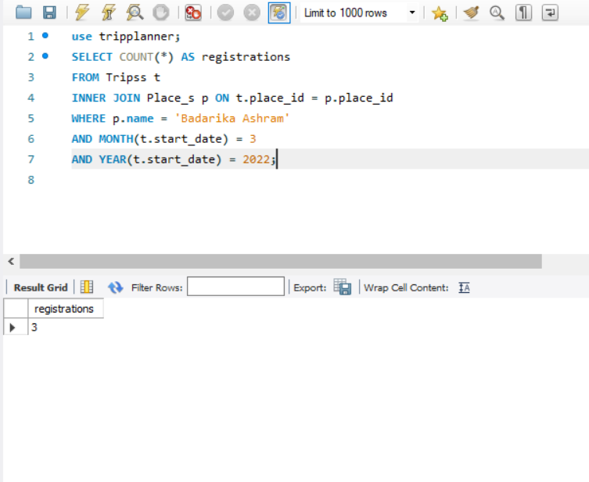
Display the Number of Customers who Registered for “Badarika Ashram in the Month of March 2022”
SELECT COUNT(*) AS registrations
FROM Tripss t
INNER JOIN Place_s p ON t.place_id = p.place_id
WHERE p.name = 'Badarika Ashram'
AND MONTH(t.start_date) = 3
AND YEAR(t.start_date) = 2022;

Slide 9
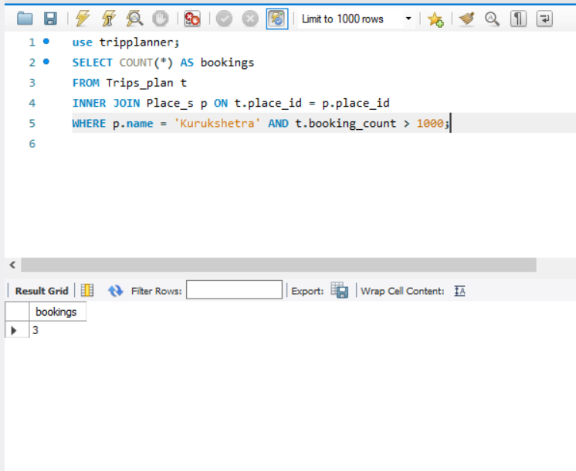
Display the Bookings count is >1000 for the place Kurukshetra.
SELECT COUNT(*) AS bookings
FROM Trips_plan t
INNER JOIN Place_s p ON t.place_id = p.place_id
WHERE p.name = 'Kurukshetra' AND t.booking_count > 1000;

Slide 10
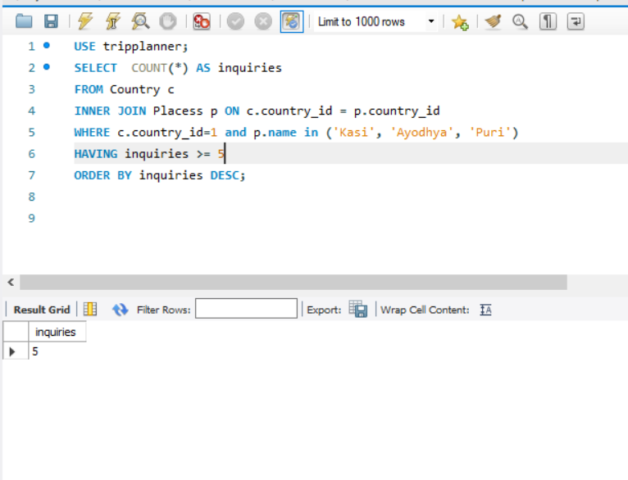
List out most Opted Destinations in India.
SELECT COUNT(*) AS inquiries
FROM Country c
INNER JOIN Placess p ON c.country_id = p.country_id
WHERE c.country_id=1 and p.name in ('Kasi', 'Ayodhya', 'Puri')
HAVING inquiries >= 5
ORDER BY inquiries DESC;

Slide 11
CONCLUSION
A good Trip Planner application in SQL should have a well-designed database schema, a user-friendly interface, robust security measures, and the ability to efficiently manage and manipulate data to provide accurate and relevant information to users. The application should be able to handle a large volume of data while maintaining good performance. The application should have a user-friendly interface that allows users to search and filter options based on their preferences, view and compare prices, and make reservations or bookings. The application should also have appropriate security measures in place to protect user data. The success of a Trip Planner application in SQL can be determined by how effectively it can manage and manipulate data to provide users with accurate and relevant information. The application should be able to generate reports, provide real-time updates, and offer personalized recommendations based on the user's search history and preferences.

